Slide 1
Unit Tests – Part 1
IS&T Attic Tech Talk
May 17, 2013
ZDF

Slide 2
New Concepts
Unit Testing with PHP
Set up
Composer
PHAR Files
Test Driven Development
Writing Tests
Vocabulary
Later…
Persistence Layers (ORM/ActiveRecord/Table Gateways)
Mocking
CakePHP Specifically

Slide 3
Files and Code
http://github.com/zfowler-uno/phpunit-techtalk
Assumptions:
WAMP installed c:\wamp
PHPStorm is installed
Path to PHP is in environment variables
C:\wamp\bin\php\php5.3.8
Hint: Advanced System Settings->Environment Variables->PATH
Don't worry if you have a mac. It's even easier to set up.
Download wamp from
http://www.wampserver.com/en/
PHAR files also in repo downloads/

Slide 4
The Plan
Install composer (slight tangent)
Install PHPUnit
Using composer
Using PHAR
Do a bit of Test Driven Development (TDD)
Intro to Flow of TDD
Create a test class for a calculator
Create a calculator
Set up PHPUnit in PHPStorm
Run a few tests
Wrap up

Slide 5
Install Composer
Download composer-setup for windows
See downloads
Or http://getcomposer.org/Composer-Setup.exe
Error about openssl –
I changed php.ini files (via wamp) to turn on openssl
Still got the error because installer is using php.ini for CLI
Open c:\wamp\bin\php\php5.3.8\php.ini
Uncomment openssl.dll line in extensions section
composer.phar – for use with PHPStorm
Drop this in a folder that's accessible
C:\wamp\bin\composer.phar
Or use PHPStorm's built-in "Download from get-composer" link

Slide 6
About PHPUnit
"Executable"
php ./path/to/phpunit.phar ./path/to/test/file.php
You build test cases with special naming conventions
class Calculator_Test extends PHPUnit_Framework_TestCase {}
You build assertions
$result = $calc->add(10,5);
$this->assertEquals(15, $result);
Then you run phpunit to test those assertions
FAILURES!
Tests: 1, Assertions: 1, Failures: 1.

Slide 7
Using Composer to install PHPUnit
Build composer.json file in project root
composer.json
{
"require-dev": {
"phpunit/phpunit":"3.7.*"
}
}
Assuming "composer" is in the path, thanks to the installer
On command line, in project's root
composer install --dev
Wait.
Done: Explore

Slide 8
Use PHAR file to install PHPUnit
Download phpunit.phar file from repo
Or, from http://pear.phpunit.de/get/phpunit.phar
Drop it in an easy-to-find location, or one with your php.exe path
C:\wamp\bin\phpunit.phar
C:\wamp\bin\php\php5.3.8\
PHPStorm will look in
The project's include path
Specified location (We'll do this in a bit)

Slide 9
Let's do some TDD
Intro to Flow of TDD
Create a test class for a calculator
Create a calculator

Slide 10
TDD Flow
There are three core rules to TDD:
You are not allowed to write any production code, if there is not a failing test to warrant it.
Write tests first
You are not allowed to write more of a unit test than is strictly necessary to make it fail. Not compiling / running is failing.
Start insanely simple. Once piece at a time.
You are not allowed to write more production code than is strictly necessary to make the failing test pass.
Hardest thing to do if you're used to just "winging it"
(Kent Beck, 2002)

Slide 11
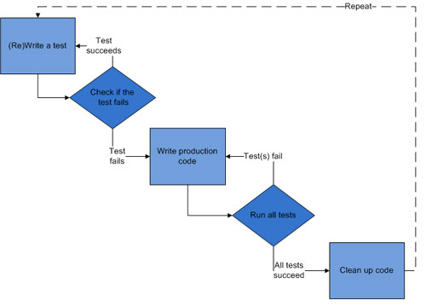
TDD Flow
Think ahead. Plan.
Add a test
Run all test, look for failures
Write some code
Run the tests again to see them succeed
Refactor code
Repeat
Image courtesy of http://en.wikipedia.org/wiki/Test-driven_development and http://net.tutsplus.com/tutorials/php/the-newbies-guide-to-test-driven-development/

Slide 12
Test Set Up
Any test should be breakable into four parts:
Setup – whatever needs to be prepared before the code can be run
Exercise – run the code we want to test
Verify – compare the result of the run with some expected condition
Teardown – cleanup all the extra stuff we used for testing so that the system is in the same state as it was before we started the current test (the state from before the Setup step).
http://net.tutsplus.com/tutorials/php/deciphering-testing-jargon/

Slide 13
TDD Vocabulary
Fixture
Represents all information that the test needs in order to be executed
Could be a plain object, or something that populates databases
SUT - System Under Test
All the things required to be tested.
Testing Framework
Application spec designed for testing in a language.
PHPUnit, JUnit, ShUnit (Shell) ... based on SUnit from Smaltalk
Test Case
Smallest unit of testing. Kent Beck did the work here.
Test Method
Smallest part of test architecture.
The test itself: includes setup, exercise, verify, teardown. It does the work.
Dependent-On Component
All other classes / system components that the SUT needs to properly run.
DOC has to provide specific methods that allow us to observe and test it.
We're not hitting this today.
Concepts of mocking and test doubles are related to DOC
More next time..
Mocking, Test Doubles, …

Slide 14
Create Calculator Tests
1. Create the test class and the first test
<?php
class CalculatorTest extends PHPUnit_Framework_TestCase {
// add function test
function testAdd() {
$c = new Calculator();
}
}
2. Run Test
3. It will fail
4. Respond, by writing the require and class def.
5. Repeat:
Add $result = $c->add(10,5);
Test.
Write Calculator::add($a, $b) in Calculator class
6. Repeat:
Add $this->assertEquals(15,$result) to test
Test.
Write return statement in Calculator::add($a, $b) so it actually does the add.

Slide 15
Using TDD
Now, let's go and create the tests for
Subtract
Divide
Multiply
Write tests for subtract
Then go write methods in calculator class.
Use TDD iterative process
Repeat for divide and multiply.

Slide 16
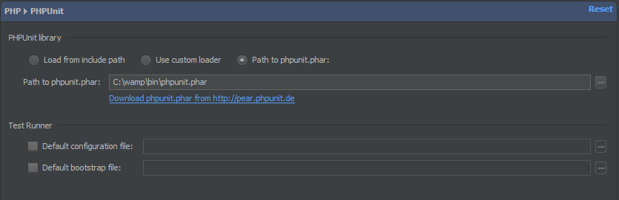
Set up PHPUnit in PHPStorm
Since you have the PHAR file already…
Open up PHPStorm
Go to the settings menu (File…Settings)
Find PHP->PHPUnit
Point the dialog box to your phpunit.phar file location.
… Done.

Slide 17
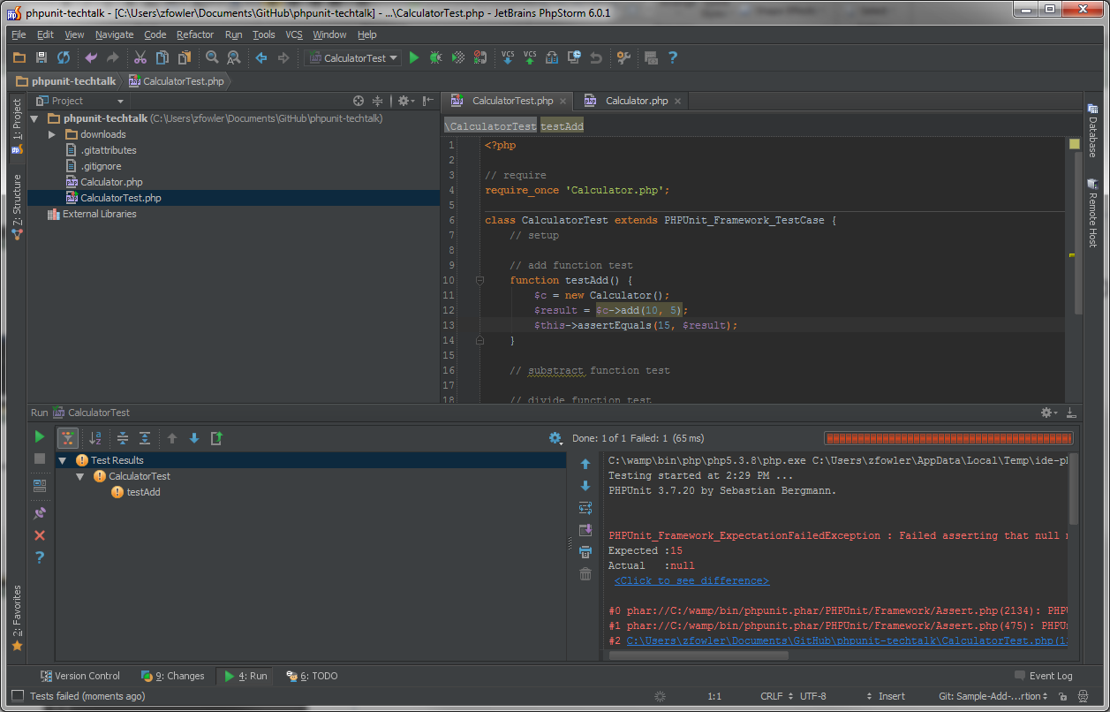
Use PHPUnit in PHPStorm
Open your code folder
Right click the CalculatorTest.php file: Run CalculatorTest
Unit Test Results

Slide 18
Wrap up
Welcome to Test Driven Development!
Unit Tests are a big part of this, as you see.
Where is this heading?
When you have good testable code:
Automated commits with refusal on test failure
Continuous integration
Writing good tests:
Learn and use better OOP: Dependencies, Abstraction and Interfaces
You know it works with normal and exception cases
Next up: Fixtures, Mocking, Dependency injections…
Depending on other tech talk topics and weeks left!

Slide 19
The End

